Slide 1
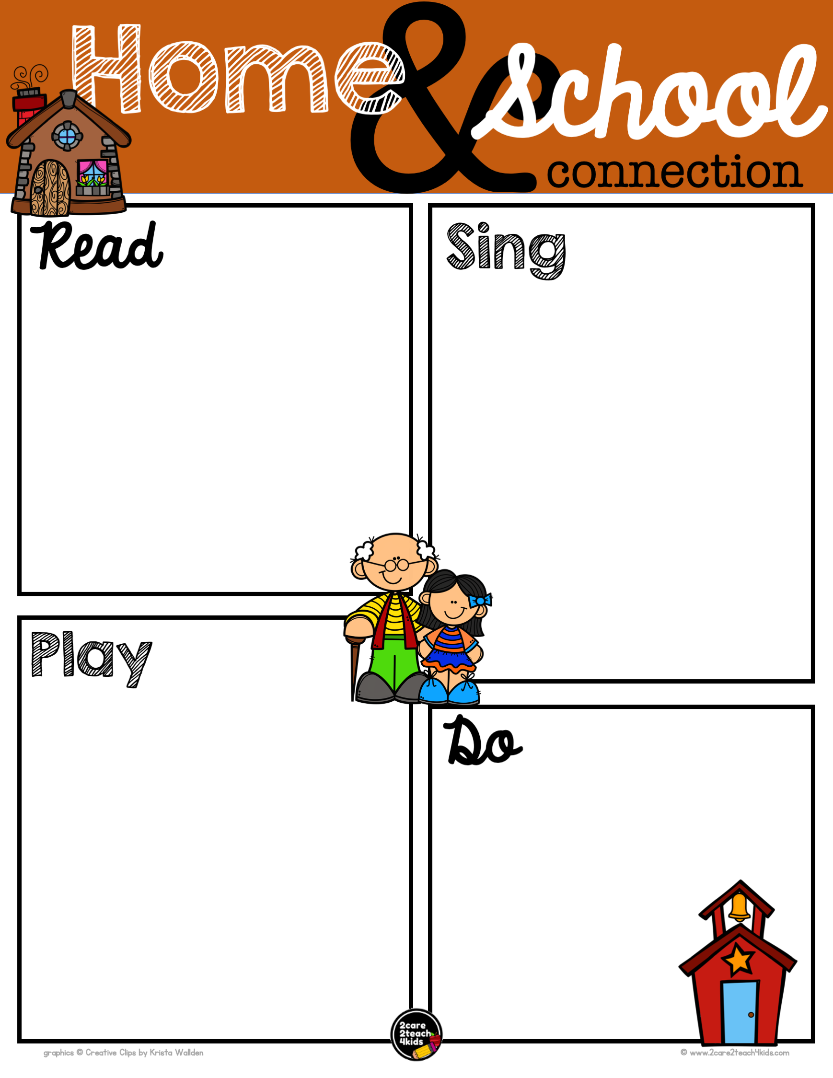
Type Here
Type Here
Type Here
Type Here

Slide 2
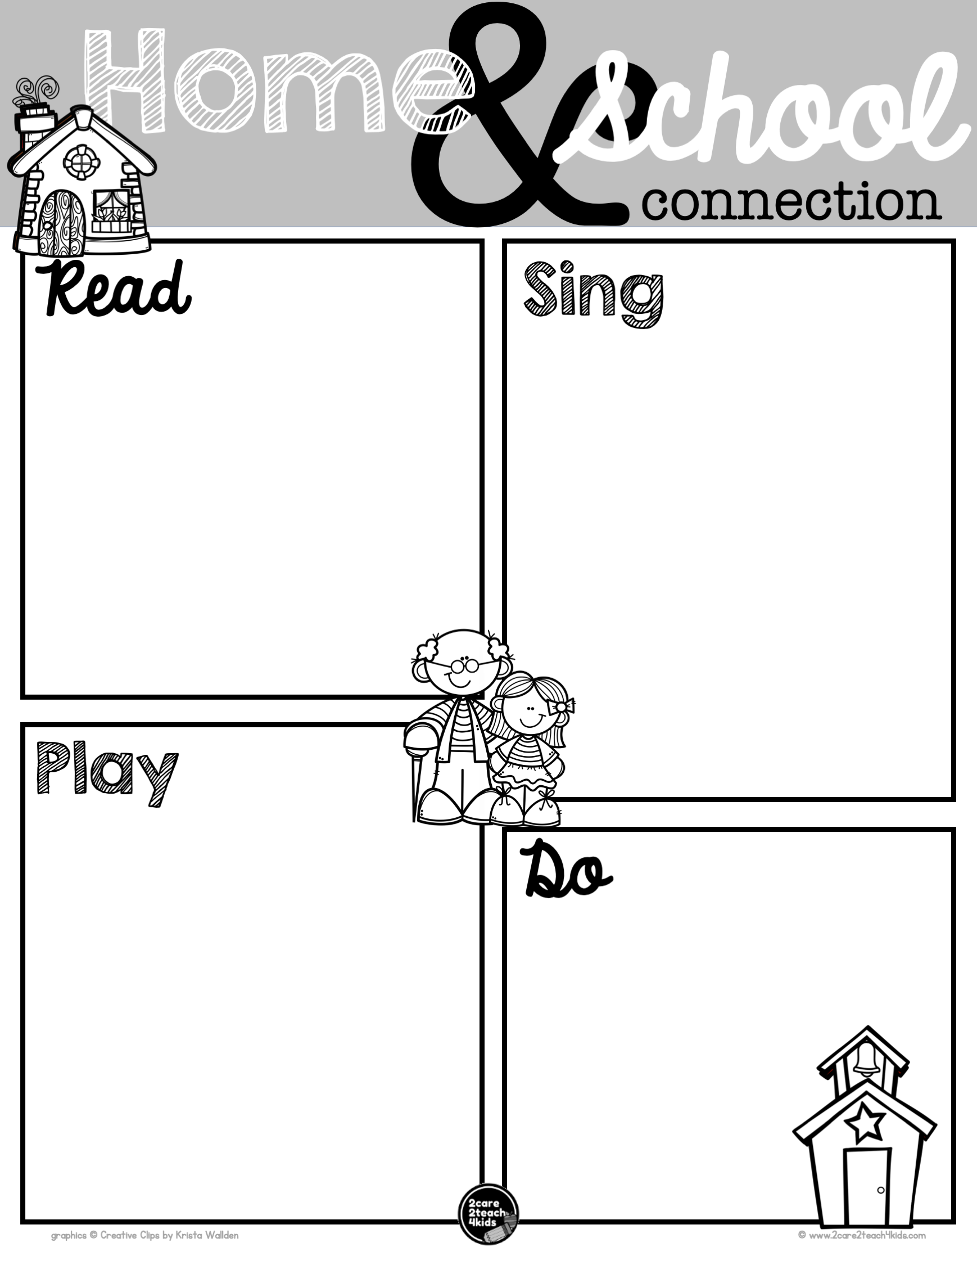
Type Here
Type Here
Type Here
Type Here

